Slide 1
Lesson #3 CAUSE AND EFFECT

Slide 2
Lesson Outline
Discussion
Academic Reading
Abstract vs Introduction
Expressing cause and effect

Slide 3
Academic Reading
You are reading Tourism Marketing. Read the text extracts and decide which are the most suitable for academic use, and why.

Slide 4
1
To promote tourism and market destination, it is important to study the tourists’ attitude, behavior and demand. The studies of Levitt (1986) and Kotler and Armstrong (1994) suggest that an understanding of consumer behavior may help with the marketing planning process in tourism marketing. The research of consumer behavior is the key to the underpinning of all marketing activity which is carried out to develop, promote and sell tourism products (Swarbrooke and Horner, 1999; Asad, 2005). Therefore, the study of consumer behavior has become necessary for the sake of tourism marketing.

Slide 5
2
The romance of travel has always fascinated me, and our recent trip to Thailand lived up to expectations. We flew from Dubai and after a comfortable flight arrived in Bangkok just as the sun was rising. Our stay in the city lasted only a couple of days before we set off for the hill country around Chang Mai, where we were planning to visit some of the indigenous tribes who live in this mountainous region. When we arrived, the weather was rather disappointing, but after a day the heavy rain gave way to sparkling clear sunshine.

Slide 6
3
Holiday trips to the Antarctica have quadrupled in the past decade and last year
more than 46,000 people visited the land mass and surrounding oceans. However,
safety fears and concerns about the impact visitors are having on the delicate
frozen landscape have soared and members of the Antarctic Treaty – an agreement between 28 nations, including the UK, on the use of the continent – are now meeting to discuss ways to regulate tourism.
British officials are seeking to establish a ‘strategic agreement for tourism’ around
the South Pole. If successful, it will see treaty members introduce new measures to improve the safety of tourist trips, while also reducing the impact that visitors will have on the environment. The regulations could see limits on the number of ships and landings, restrictions on how close they come to shore, a ban on building tourist facilities and hotels on the continent, and rules on waste discharges from ships.

Slide 7
4
Equally, from a political perspective, the nature of state involvement in and
policies for tourism is dependent on both the political-economic structures and the prevailing political ideology in the destination state, with comparisons typically made between market-led and centrally planned economies. For example, the Thatcher–Reagan-inspired neo-liberalism of the 1980s, and the subsequent focus on privatization and the markets in many Western nations contrasted starkly with the then centrally planned tourism sectors in the former Eastern Europe (Buckley and Witt, 1990; Hall, 1991). At the same time, of course, it has also long been recognized that the political-economic relationship of one nation with another or with the wider international community (that is, the extent of political-economic dependency) may represent a significant influence on tourism development (Telfer, 2002). Thus, in short, tourism planning and development in the destination tends to reflect both the structures and political ideologies of the state and its international political-economic relations.

Slide 8
Text # | Suitability for academic use
1
2
3
4

Slide 9
The main features of academic tests are listed in the table below. Find examples of each using the texts above.
Feature | Examples
1. Formal Vocabulary
2. Use of reference
3. Impersonal style
4. Long and complex sentences

Slide 10
Text type | Advantages | Disadvantages
textbook | reliable | difficult, not relevant , general information
scientific article | more detailed more accurate up to date | possibly unreliable,
reports | easy to read
websites | east to access | not reliable , not objective, risk of bias
magazine article

Slide 11
Developing Critical Approaches
To take critical approach to texts
To understand well what is written in the text
Techniques/strategies/methods
Scanning
Skimming
Surveying
Extensive reading
Intensive reading

Slide 12
Complete the empty boxes in the chart with the following techniques.
Read title and sub-title carefully
Read intensively to make notes on key points
Scan text for info
Survey text features
Skim text for gist – is it relevant?
Read extensively when useful sections are found

Slide 13
Author: is the writer well-known in his/her field? What else has he/she published?
Publication date and edition: do not use a first editions if there is a second edition
available.
Abstract/Summary: is it worth reading the full article?
Contents: a list of the main chapters or sections. This should tell you how much space is given to the topic you are searching.
Introduction or Preface: This is where the author often explains his/her reasons for writing and also describes how the text is organized.
References/Bibliography

Slide 14
Facts and Opinions
Almaty is the former capital of Kazakhstan. (Fact)
Almaty is a welcoming, bustling city. (Opinion)
Almaty lies near the mountains. (True)
Almaty was an ancient trading port. (False)

Slide 15
Read the following and indicate facts and opinions. Decide if the facts are True or False.
Sydney is the capital of Australia.
Australia is a dynamic, prosperous city.
The majority of Australians live on sheep farms.
Most Australians are open-minded and friendly.
Australia is the largest island in the world, and has extensive mineral deposits.
Among the 22 million Australians are some of the world’s best cricket players.

Slide 16
Critical Thinking
What are the key ideas/main ideas in this?
Does the argument of the writer develop logically, step by step.
Are the examples given helpful? Would other examples be better?
Does the author have any bias (leaning to one side or the other)?
Does the evidence presented seem reliable?
Do I agree with the writer’s views?

Slide 17
COLLEGE CONCERNS
Despite their dominance of global league tables (e.g. Shanghai Rankings Consultancy) American universities currently face significant criticism. The American Enterprise Institute (AEI) and the Goldwater Institute have recently published negative reports on US universities, while a highly critical book (Hacker and Dreifus) was published in 2010. The critics focus on the rising costs of American higher education, which have increased at a much faster rate than inflation, resulting in a situation where even middle-class families are finding the expense unsupportable.
Another target of criticism is the focus on research at the expense of teaching. Students rarely meet the ‘star’ professors, being taught instead by badly-paid graduate students. It is claimed that in one year nearly half of Harvard’s history professors were on sabbatical leave. As a consequence, students work less; according to the AEI they currently study for 14 hours per week, whereas 50 years ago the figure was 24 hours per week. Despite this the proportion of students gaining a first or 2.1 degree has increased significantly: a situation described by the critics as ‘grade inflation’.

Slide 18
B. A BRIGHTER TOMORROW? There is little doubt that a university degree is the key to a better future for any student. Despite the costs involved in terms of fees, it has been calculated that the average UK university graduate will earn £400,000 ($600,000) more over his or her lifetime compared to a non-graduate. Possession of a degree should also assist a graduate to find a satisfying job more quickly and give greater prospects for promotion inside the chosen career. A degree from a British university is recognised all over the world as proof of a high quality education.
A university course will not only provide students with up-to-date knowledge in their subject area, but also provide practice with the essential skills required by many employers today, such as the ability to communicate effectively using ICT, or the skills of team working and problem solving. In addition, living away from home in an international atmosphere gives the opportunity to make new friends from all over the world, and build networks of contacts that may be invaluable in a future career.
Studying at university is a unique opportunity for many young people to develop individually by acquiring independence, free from parental control. They will learn to look after themselves in a secure environment, and gain useful life skills such as cooking and budgeting. Most graduates look back at their degree courses as a valuable experience at a critical period of their lives.

Slide 19
Abstract vs Introduction

Slide 20
Abstract | Introduction
Summarizes the whole text | Introduces the text
IMRaD = Abstract | Does not contain results, conclusion, recommendations.
Can stand alone as a separate entity. | May not make a sense without the main text.
Present Simple (the aim and purpose) Past Simple (methods) | Present Simple: to begin the Intro The Present Perfect: to show how the problem has been approached from the past until the present.

Slide 21
Abstract | Introduction
Questions to structure Why this study? What did you investigate? What did you do? What did you find? What do your result mean? So what? | Questions to structure What is the problem? Are there any existing solutions (i.e. in the literature)? Which solutions is the best? What is its limitation? (What gap am I hoping to fill)? What do I hope to achieve? Have I achieved what I set out to do?

Slide 22
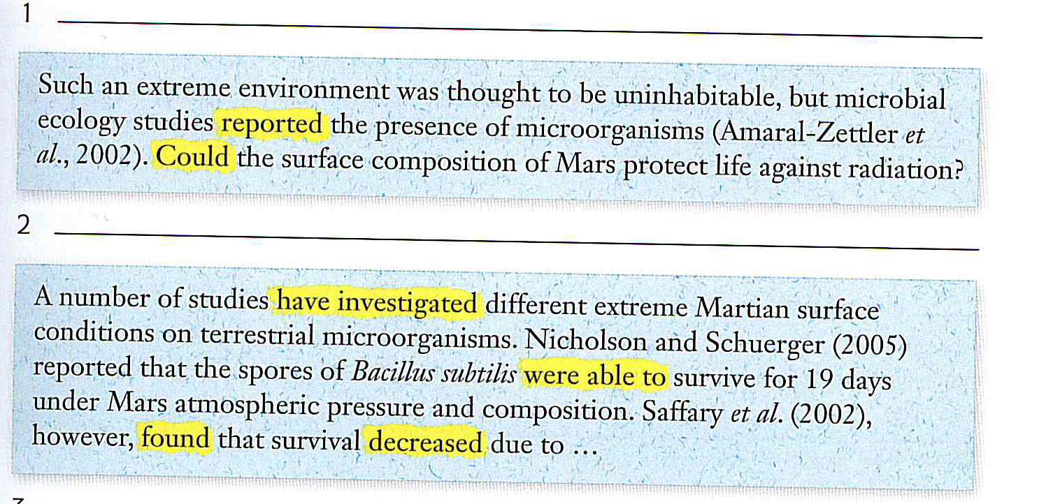

Slide 23
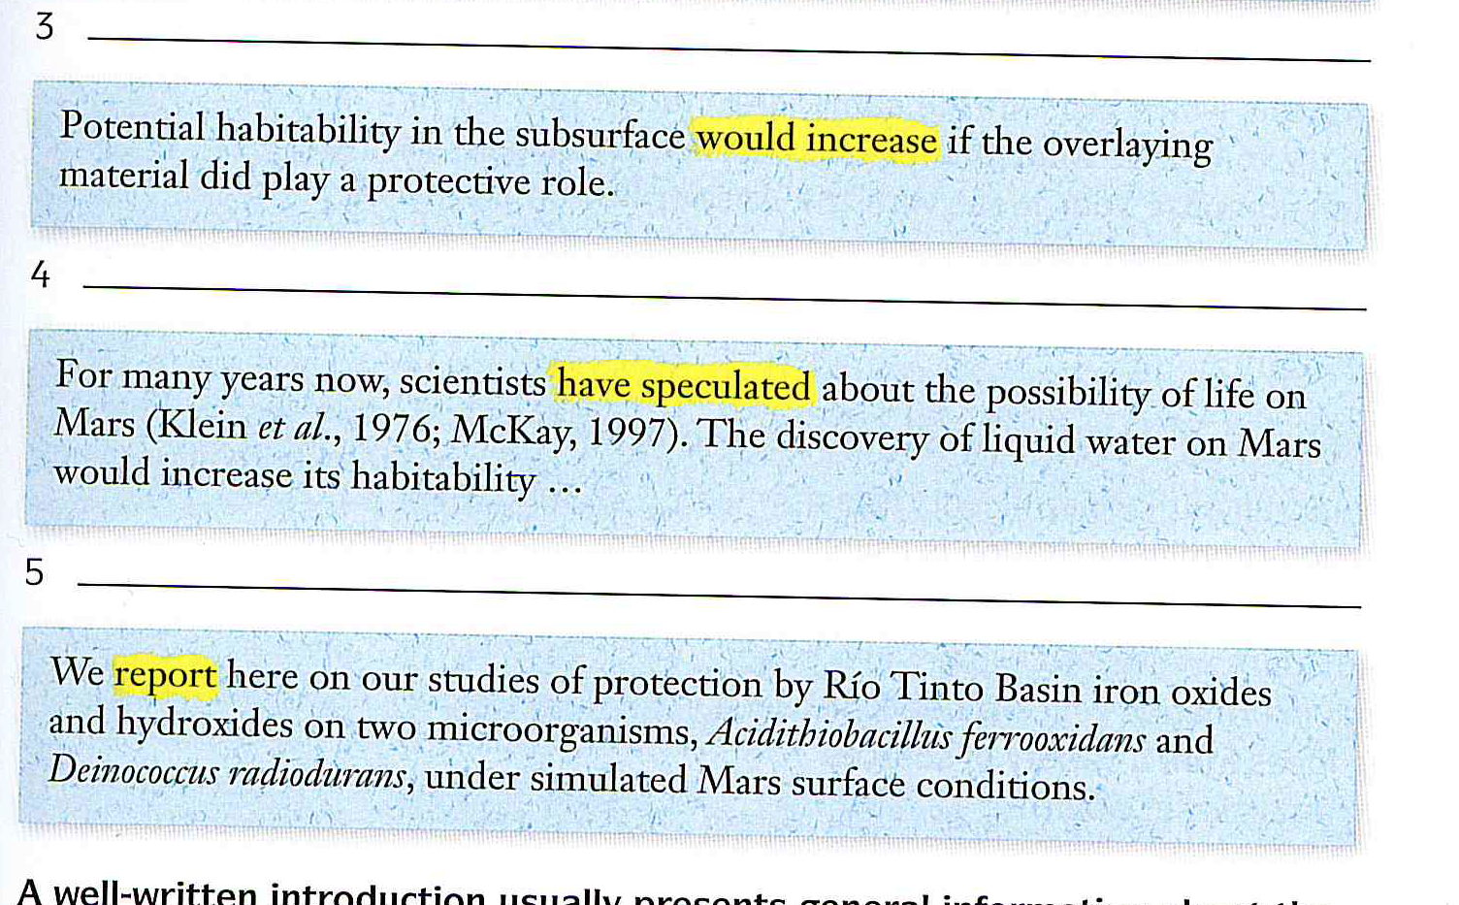

Slide 26
Citizenship Norms and the Expansion of Political Participation
Russell J. Dalton
A growing chorus of scholars laments the decline of political participation in America, and the negative implications of this trend for American democracy. This article questions this position – arguing that previous studies misdiagnosed the sources of political change and the consequences of changing norms of citizenship for Americans’ political engagement. Citizenship norms are shifting from a pattern of duty-based citizenship to engaged citizenship. Using data from the 2005 ‘Citizenship, Involvement, Democracy’ survey of the Center for Democracy and Civil Society (CDACS) I describe these two faces of citizenship, and trace their impact on political participation. Rather than the erosion of participation, this norm shift is altering and expanding the patterns of political participation in America. (Dalton, R. J. (2008) Political Studies 56 (1): 76–98)

Slide 27
Cause and Effect

Slide 28
Focus on causes (with verbs)
The heavy rain caused the flood
led to
resulted in
produced

